Slide 1
TASK 2
OTBI REPORT
MASTER - DETAILS EVENT & ACTION LINKS

Slide 2
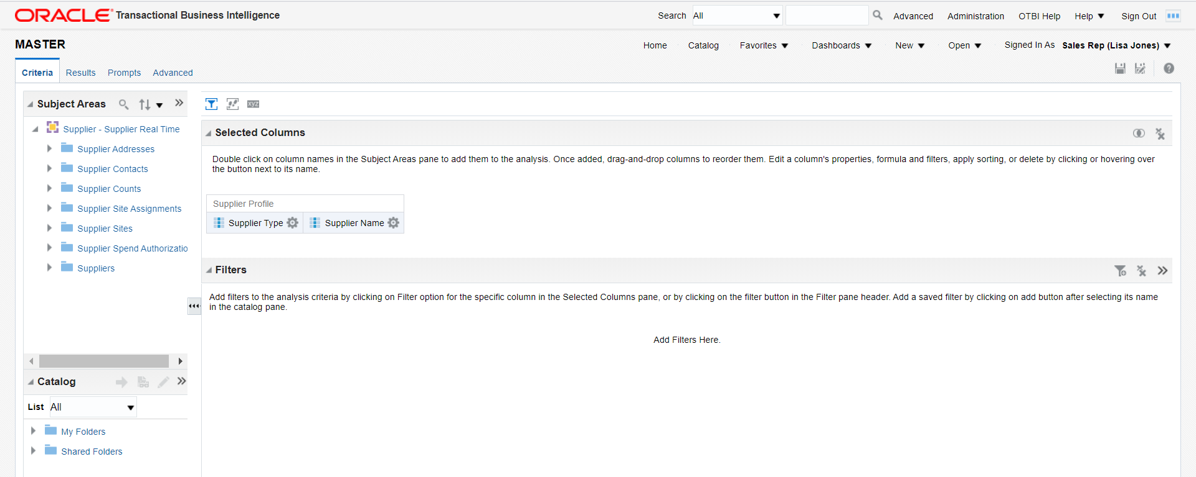
NAVIGATION - MASTER DETAILS EVENTS
Go to instance --> Browse Catalog --> New --> Analysis
Select the Subject area as Supplier Real Time
Select the Columns for Master Analysis.

Slide 3
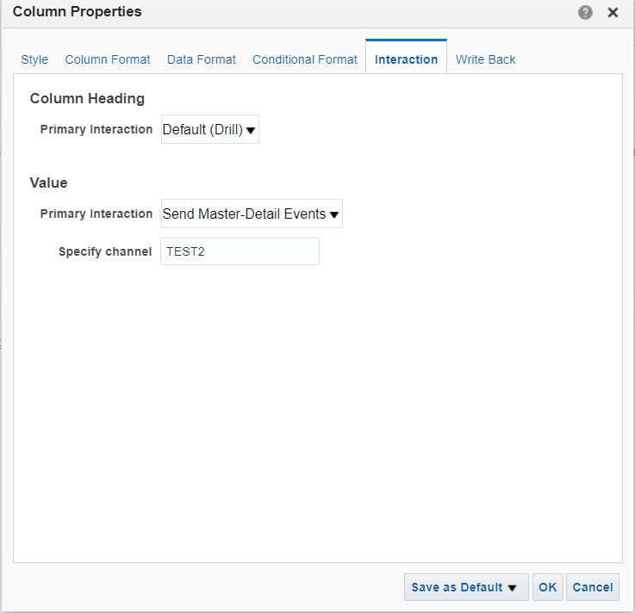
Set column properties in Supplier name.
Create a channel for Master - Details event.

Slide 4
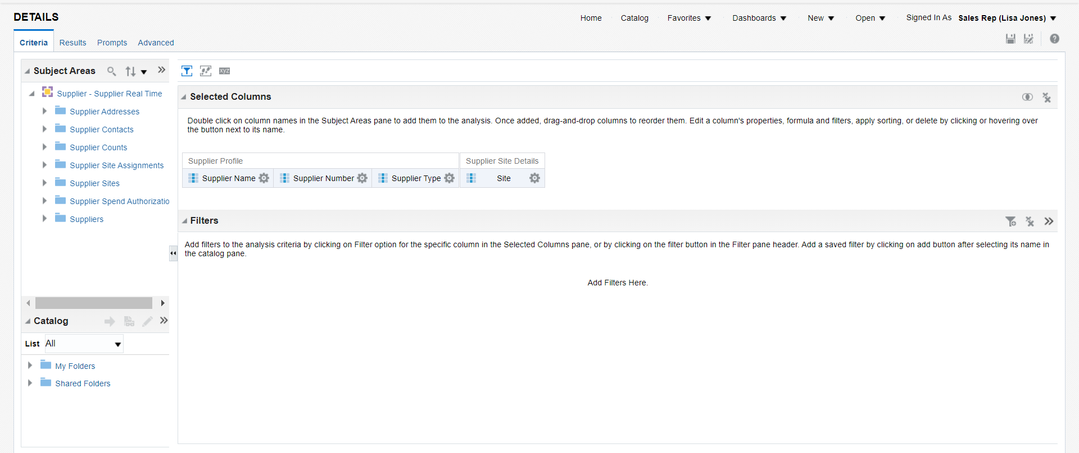
Create new analysis for Datail 1
Select subject area as Supplier Real Time
Select columns for Detail 1 analysis.
Set Supplier type and Supplier name as table prompt.

Slide 5
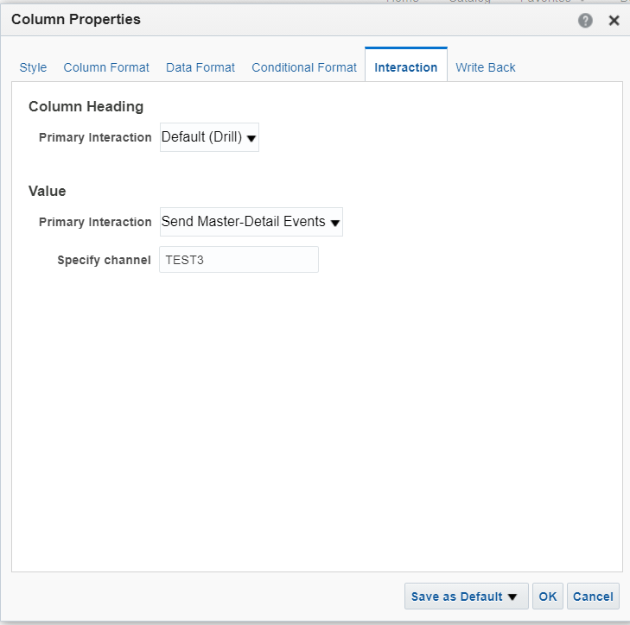
Set column properties in Supplier name.
Create a channel 2 for Master - Details event.

Slide 6
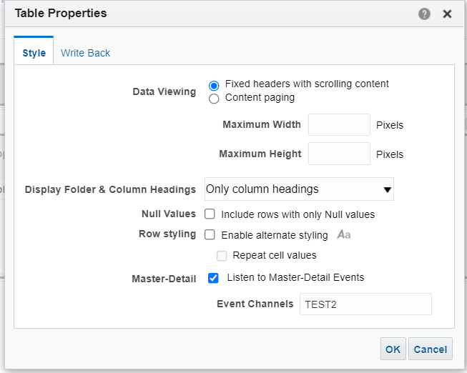
Map the channel 1 in detail1 analysis in the table properties.

Slide 7
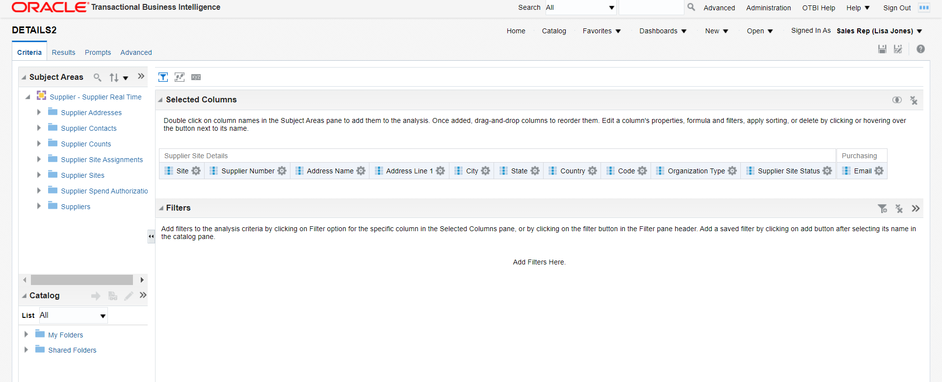
Create new analysis for Datail 2
Select subject area as Supplier Real Time
Select columns for Detail 2 analysis.

Slide 8
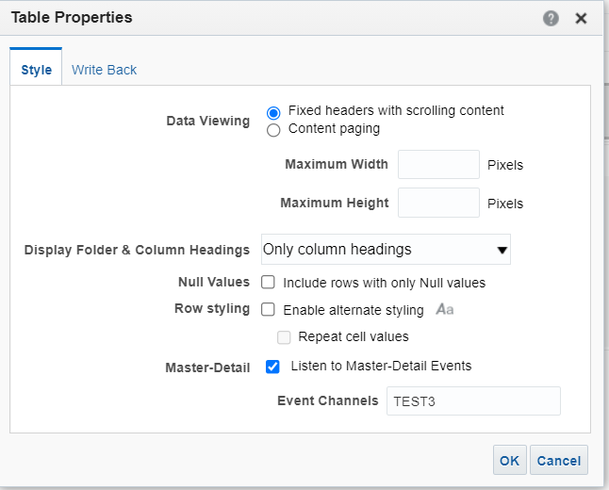
Map the channel 2 in detail2 analysis in the table properties.

Slide 9
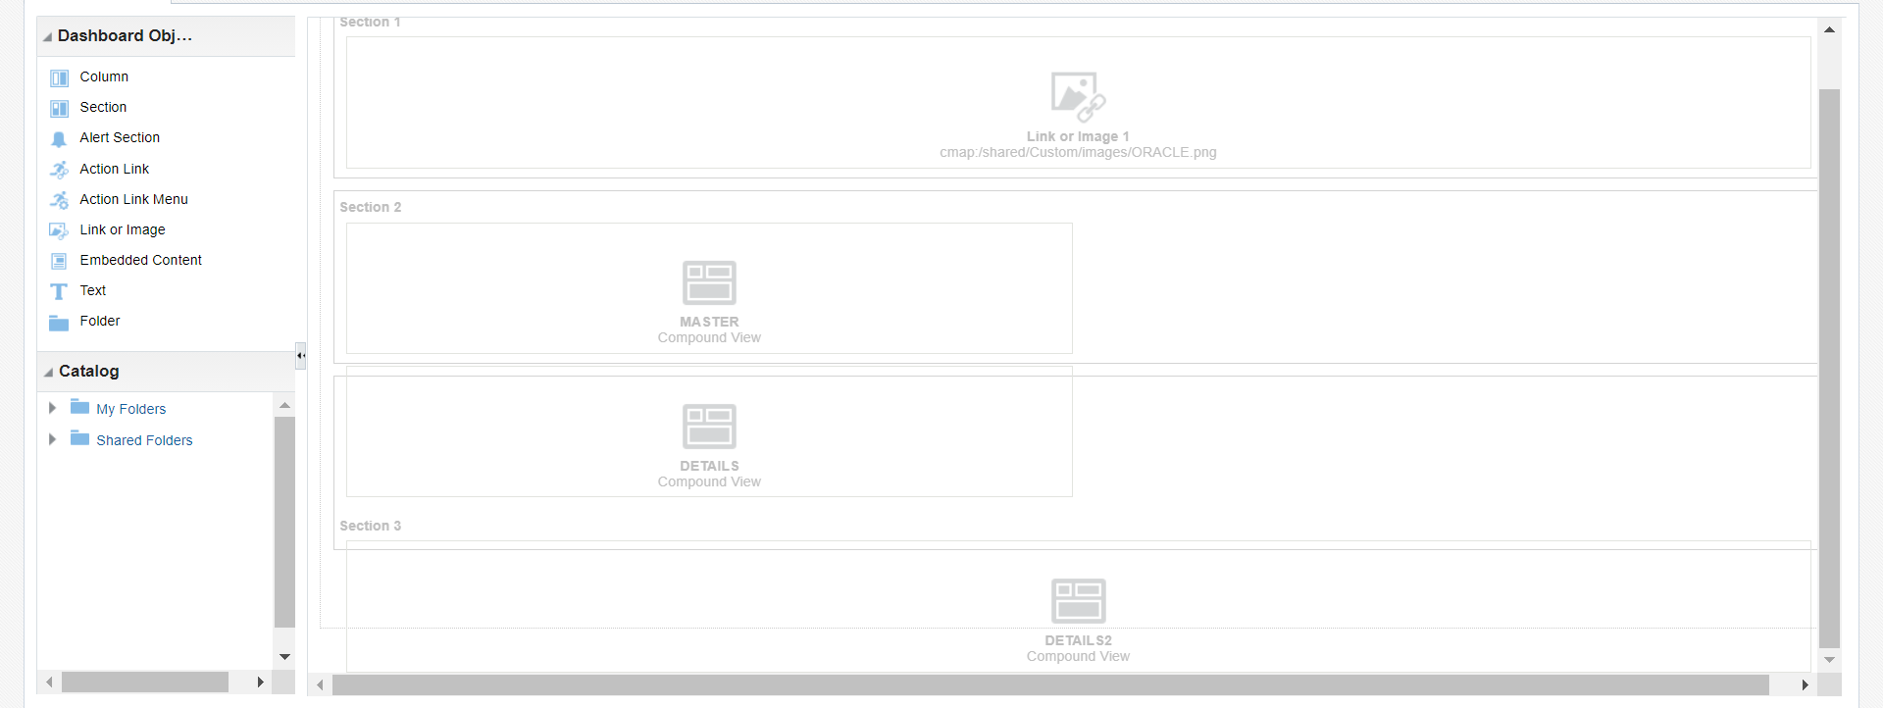
Create a Dashboard with 3 analysis.

Slide 10
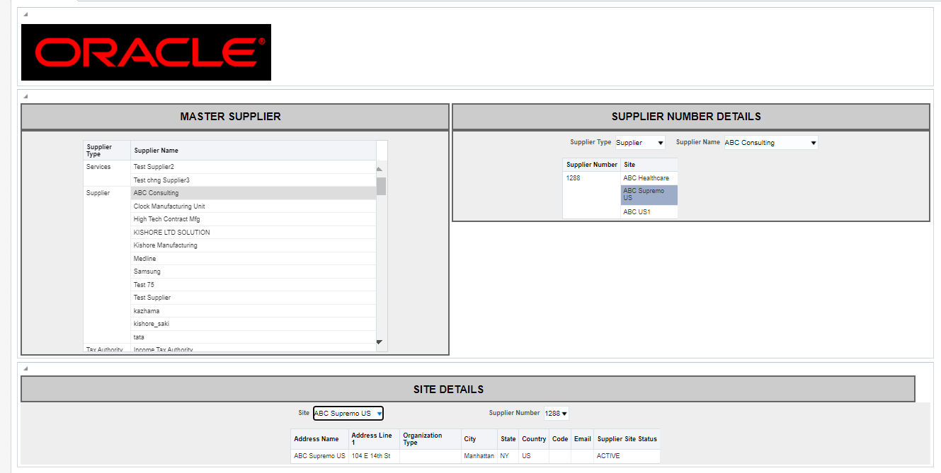
Run the dashboard.
Select the Supplier name in master analysis and supplier site in detail 1 analysis.

Slide 11
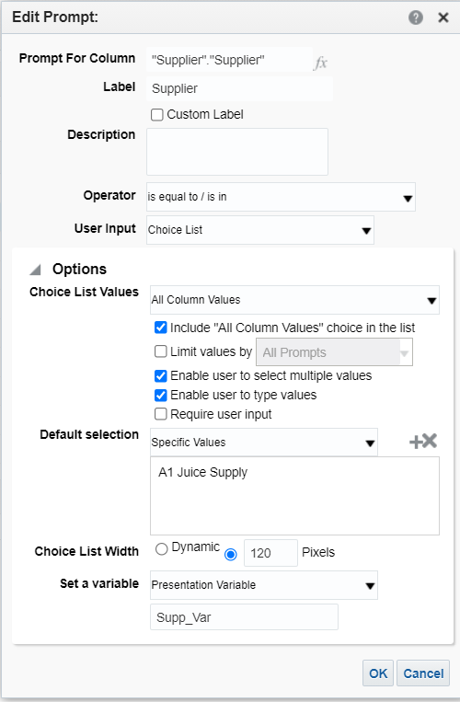
NAVIGATION - ATION LINKS
Create new dashboard prompt for supplier prompt
Select subject area as Supplier real time.
Create a prompt for supplier.
Check Include “All Column Values” choice in the list.
Create a presentation variable.

Slide 12
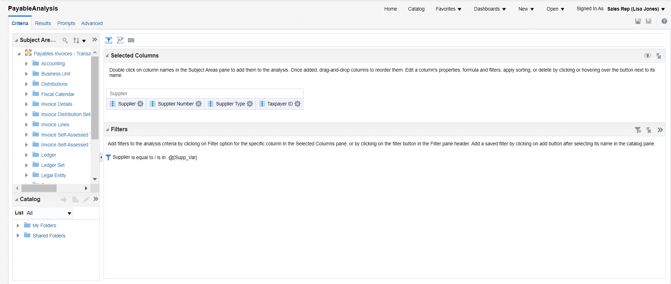
Create new analysis for payable analysis
Select subject area as Payable Real Time
Select columns for payable analysis.

Slide 13
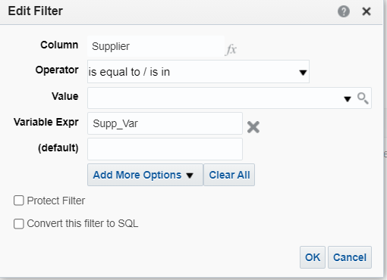
Create a filter for Supplier in payable analysis.
Map the presentation variable created in supplier prompt.

Slide 14
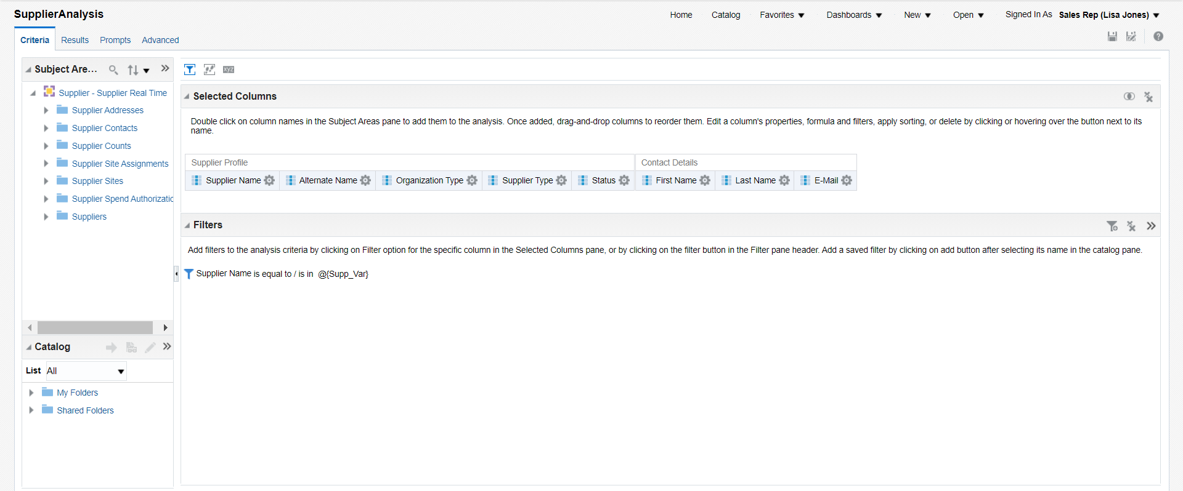
Create new analysis for supplier analysis
Select subject area as Supplier Real Time
Select columns for supplieranalysis.

Slide 15
Create a filter for Supplier in supplier analysis.
Map the presentation variable created in supplier prompt.

Slide 16
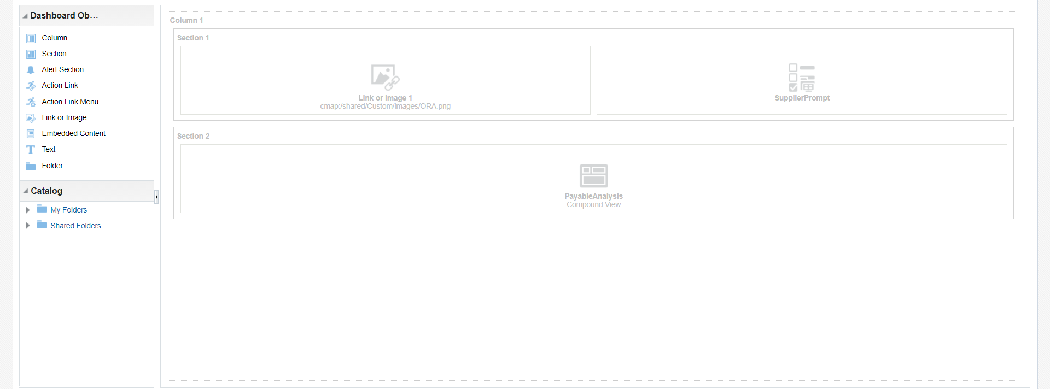
Create a Dashboard with supplier prompt and payable analysis.

Slide 17
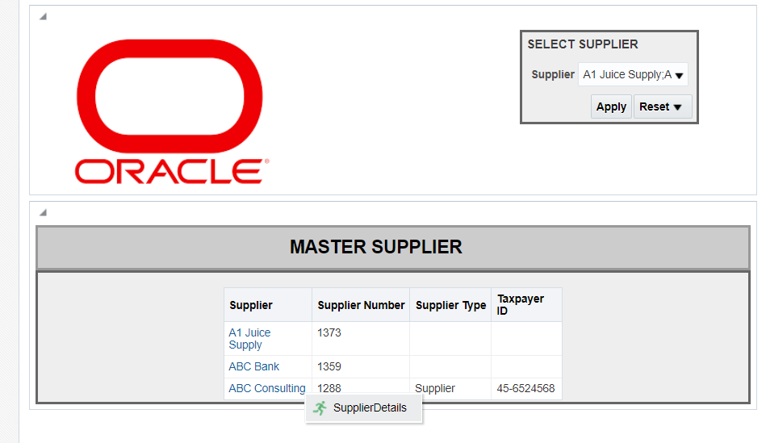
Run the dashboard.
Select the Supplier in supplier prompt and click on the supplier in payable(Master Supplier) analysis.

Slide 18
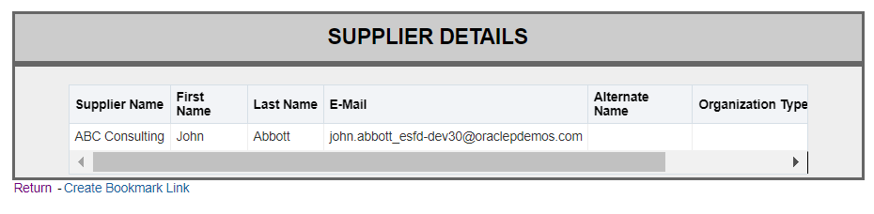
Respective supplier details is displayed in supplier analysis (Supplier Deatils)

Slide 19
END

